Slide 1
Decoders

Slide 2
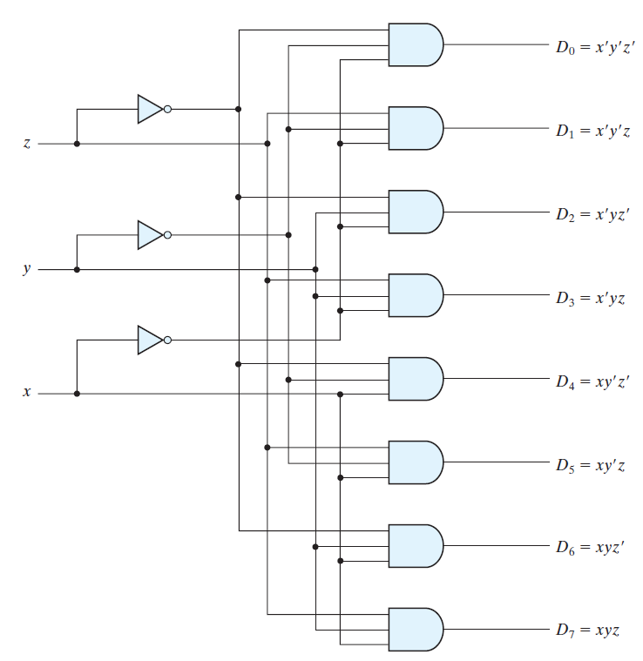
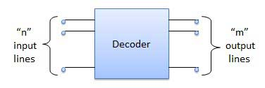
DECODERS
A decoder is a combinational circuit that converts binary information from n input lines to 2^{n} unique output lines
3-to-8-line DECODER

Slide 3
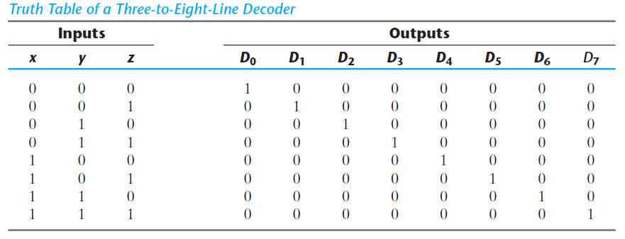
3-to-8-line DECODER Truth Table
Three inputs are decoded into eight outputs, each representing one of the minterms of the three input variable.
Application: Binary to OCTAL conversion

Slide 4
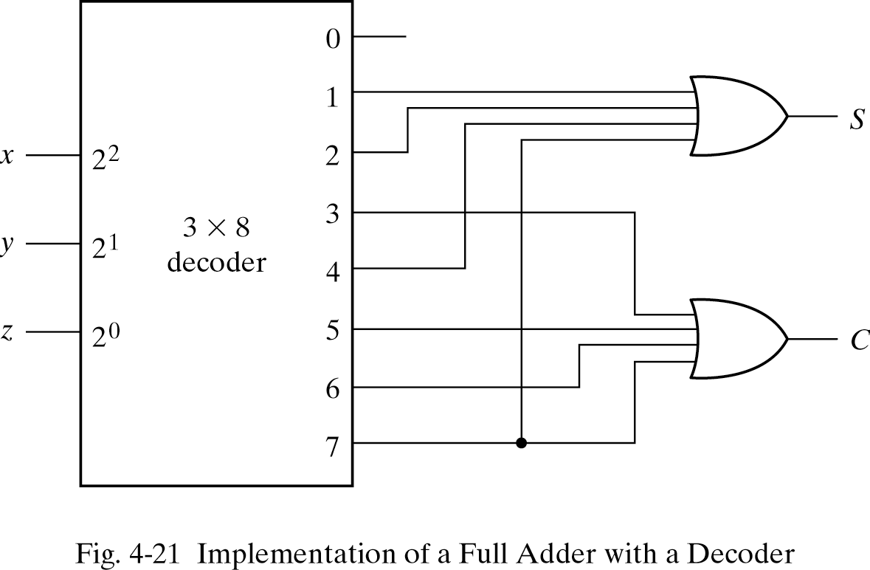
Combinational Logic (Full-Adder) using Decoder
Implementing a combinational circuit by means of a decoder and OR gates requires that the Boolean function for the circuit be expressed as a sum of minterms.
A function with k minterms has 2^{n} - k maxterms. If the number of minterms in the function is greater than 2^{n} /2, then F can be expressed with maxterms. In such a case, it is advantageous to use a NOR gate to generate the normal output F.
Notes:
For example, consider if function has 3 variables, there are 2^{n} = 8 terms. If the function is giving 1 at 6 locations, It means there are 6 minterms and 2 maxterms. Incase the minterms are greater than 2^{n} /2 ie. Greater than 8/2=4, as in this case minterms=6, then it is advantageous to generate normal output using maxterms joined together with a NOR gate.

Slide 5
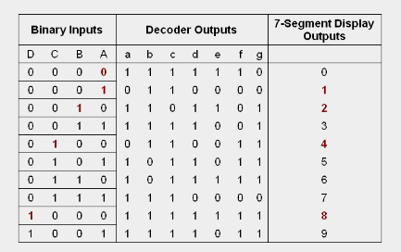
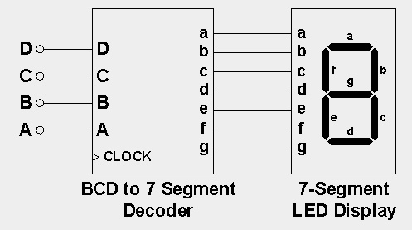
The term decoder is sometimes also used in conjunction with other code converters, such as a BCD-to-seven-segment decoder

Slide 6
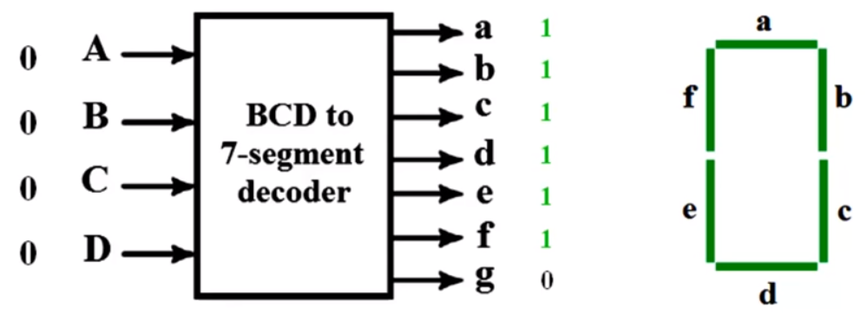
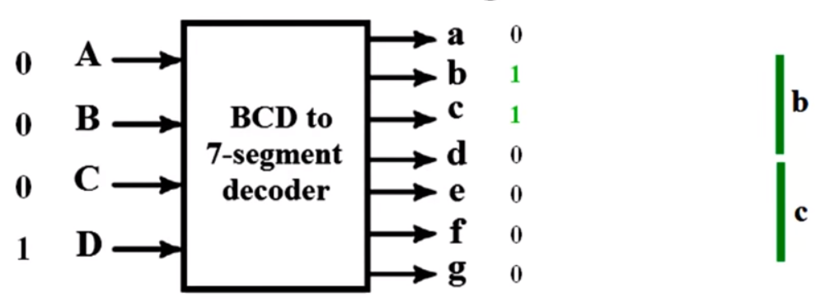
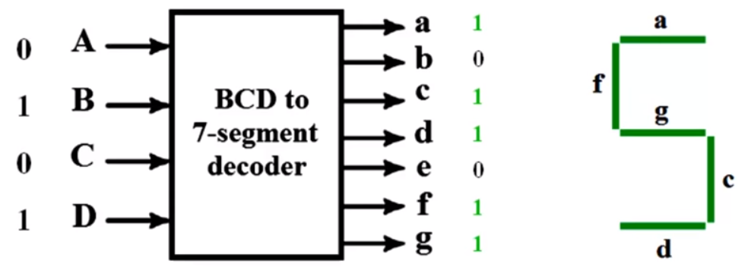
Examples

Slide 7
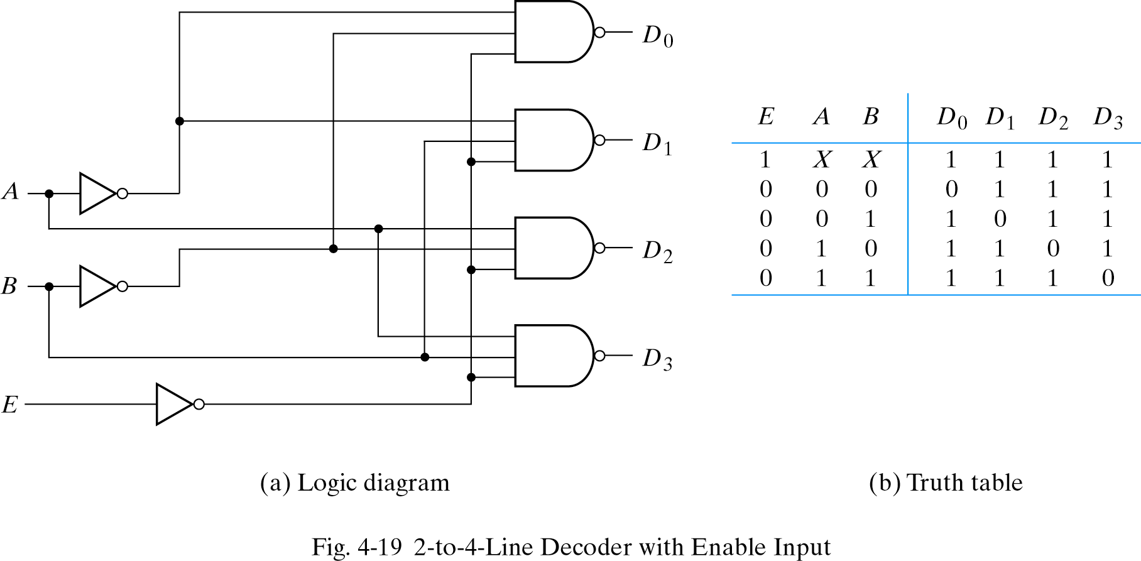
2-to-4-line DECODER with Enable Input
Decoders include one or more enable inputs to control the circuit operation. It is more economical to generate the decoder minterms in their complemented form.
The decoder is enabled when E = 0. The output whose value = 0 is basically the minterm selected by inputs A and B.
The decoder is disabled when E = 1→ D₀ … D₃ = 1
Complemented outputs

Slide 8
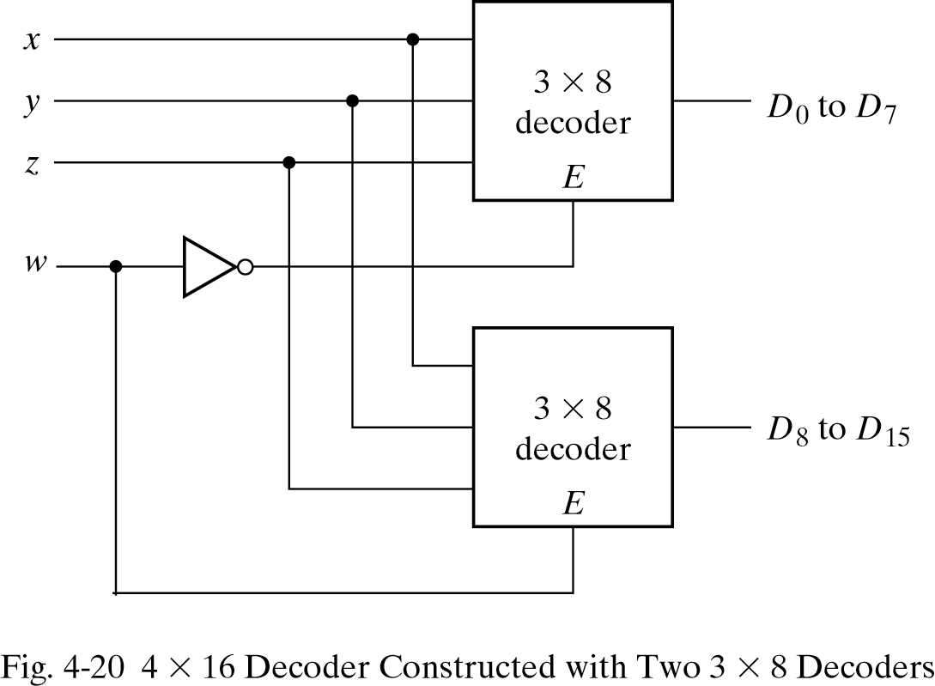
4 x 16 DECODER using Two 3 x 8 DECODER
Decoders with enable inputs can be connected together to form a larger decoder circuit.
Figure on right shows two 3-to-8-line decoders with enable inputs connected to form a 4-to-16-line decoder.
When w = 0, Top decoder generates 8 minterms 0000 to 0111, while the bottom decoder is disabled.
When w = 1, the top decoder is disabled and the bottom decoder generates 8 minterms 1000 to 1111.

